Slide 1
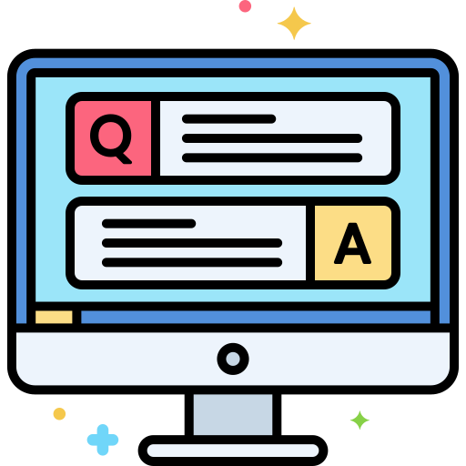

Software Quality Assurance: Introduction
QA, Testing, Bugs, Testing Principles, Testing Process
SoftUni Team
Technical Trainers
Software University
http://softuni.bg

Slide 2
Table of Contents
What is Software Quality Assurance (QA)?
What is Software Testing?
Software Defects (Bugs)
Manual Testing vs. Automation Testing
Seven Testing Principles
Test Scenarios and Test Cases

Slide 3
You Have Questions?
sli.do #QA-Basics

Slide 4
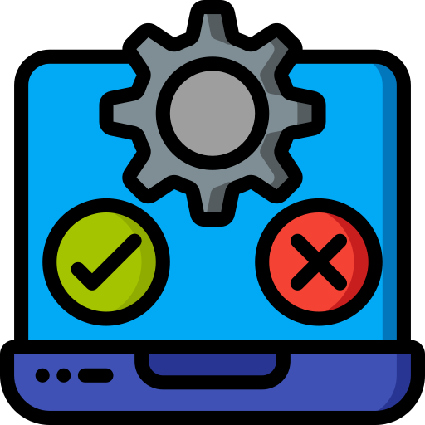
What is Software Quality Assurance?
What is Software Testing?

Slide 5
Software Quality Assurance (SQA)
What is "software quality assurance" (SQA / QA)?
SQA aims to assure that the software behaves as expected
SQA is a methodology of checking that software complies with the requirements
Most of the QA work is software testing: manual and automated
Bugs are reported and tracked via bug tracking systems
The QA process is performed by QA engineers
Notes:
5

Slide 6
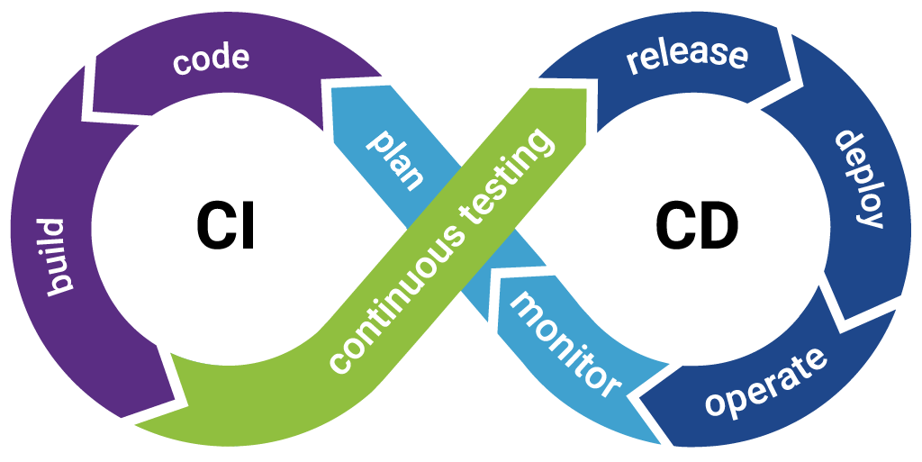
Software Quality Assurance (SQA)
Most of the QA work is software testing
Manual testing (click and check the results)
Automation testing (QA automation with scripts)
Continuous integration and delivery (CI / CD pipeline)
Automated build & deploy in a testing environment
Automated test execution
Notification / reporting
Notes:
6

Slide 7
Software Testing
Software testing is a way:
To assess the quality of the software
To verify that it satisfies specified requirements and to find bugs
To reduce the risk of software failure in operation
The process of analyzing a software item
To detect the differences between existing and required conditions
To evaluate the features of the software item
Notes:
7

Slide 8

Testing Objectives
Main objectives of testing
Prevention of defects
Verification of the specified requirements
Verification of the expected behavior of a software
To reduce the level of risk of inadequate software
To provide information to stakeholders
To comply with contractual, legal, or regulatory requirements

Slide 9

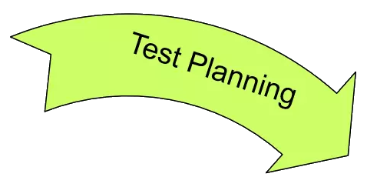

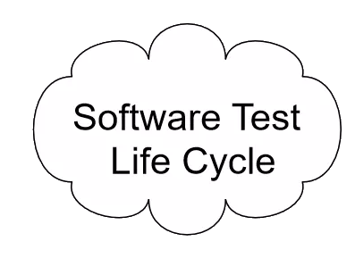
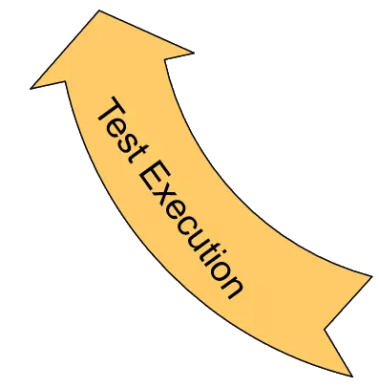
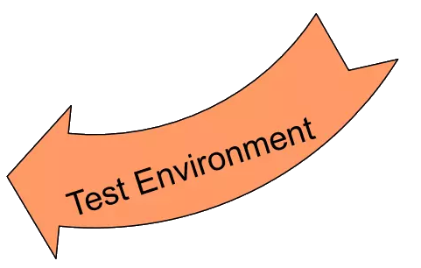
The Software Testing Process
Testing checks whether the developed software conforms to the requirements
Testing aims to find & report defects (bugs)
Software testing process includes:
Test planning: what, when, how to test?
Test design: test scenarios & test cases
Setup test environment: install, configure, prepare test data, …
Test execution: perform the tests
Test reporting: log the test results and bugs found

Slide 10

Software Defects (Bugs)
Errors, Defects, Bugs, Failures

Slide 11
Software Defects
Humans can make errors (mistakes)
Errors produce defects
Defects are bugs in the program code, or mistakes in the requirements / design / other
If a defect is executed, it might cause a failure
Fail to do what it should do / do the wrong thing
QA / software testing aims to find the defects
Automated testing and CI / CD reduce the defects
Human errors (mistakes)
Defects in the software (bugs)
Failures at runtime / incorrect behavior

Slide 12
Error vs. Defect vs. Failure
Programming error
Add function that works fine, except for 5 + 3 = 7 (latent error)
Activated error -> effective defect / bug
Call add function with 5 + 3
Get 7 in some variable (instead of 8)
Failure – deviation of system behavior
Schedule a meeting at 7:00 AM, instead of 8:00 AM
Error
Defect / Bug
Failure

Slide 13

What Could Cause Defects? (1)
The cause of developer / tester mistakes might be
Time pressure
Poor training
Code complexity
Complexity of infrastructure
Changing technologies

Slide 14





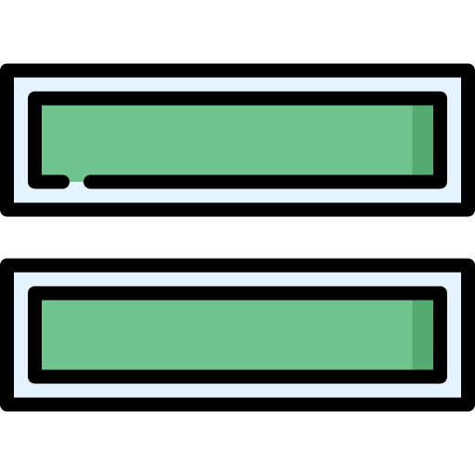
Examples
Time pressure example
10 minutes are needed to write a function
The time limit is 2 minutes
Higher probability to make a mistake
Poor training example
Physics formula needs to be implemented in the software
The developer doesn't understand the formula
Poor / wrong implementation
Code does something else

Slide 15

What Could Cause Defects? (2)
Organizational factors
Inefficient communication (misunderstanding)
Unclearly defined requirements
Environmental conditions
Electronic fields, magnetism, radiation, pollution, etc.
These can change the hardware conditions
Incorrect software environment (e. g. wrong IP address)
Example of unclearly defined requirements:
"The software shall be easy to use."

Slide 16

What Could Cause Defects? (3)
Other causes of defects:
Misconfiguration or failure of the production or test environment
Corrupted test data
False negative
False positive
Bad tests
Invalid expected results
Notes:
Book: Foundations of Software Testing ISTQB Certification - 5.6 INCIDENT MANAGEMENT

Slide 17
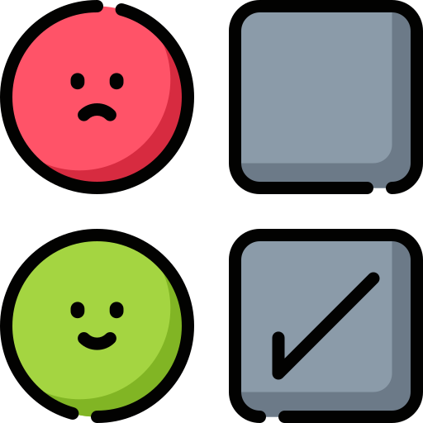
Examples
Corrupted test data example
Tester registers username "john123"
Leaves the database as it is
Second tester tries to run the same test
Registration fails due to duplication, i.e. correct test fails
Production environment misconfiguration
Disabled "send mail" function of the hosting server
User registers but does not receive an email confirmation
Notes:
Book: Foundations of Software Testing ISTQB Certification - 5.6 INCIDENT MANAGEMENT

Slide 18

Crucial Software Bugs
Billions of Dollars Lost Due to Software Bugs

Slide 19

Some Crucial Software Bugs (1)
Mars Climatе Orbiter Crash (1998)
Designed to study the Martian climate, atmosphere, surface
Expected to be on 140 – 150 km from the planet
Reached 57 km and was destroyed from the pressure
Cost: $125 million
Reason: incorrect measurement usage (imperial versus NASA specified ones)

Slide 20
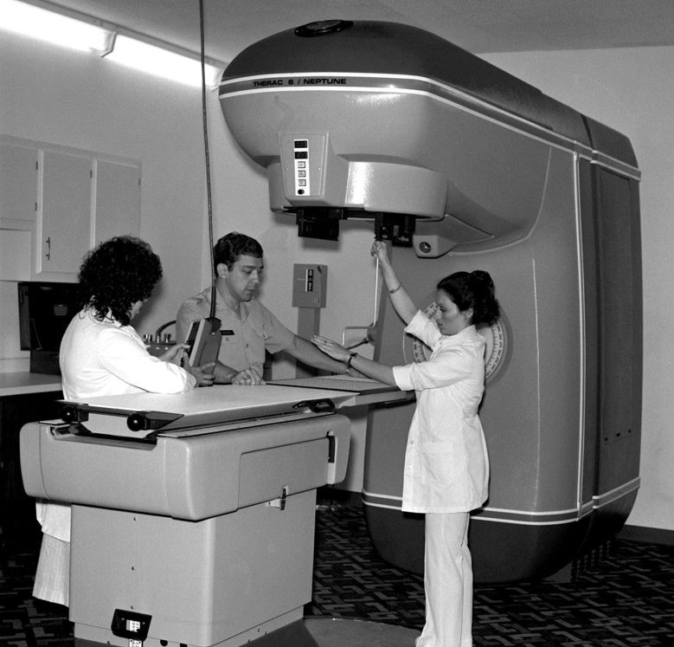
Some Crucial Software Bugs (2)
Therac-25 medical accelerator (1985-1987)
A machine meant to deliver radiation therapy to cancer patients malfunctions
Lethal radiation doses was delivered to three patients, three others severely injured
Reason: the software is falsely identifying the sum of errors as non error due to a mistake in the checking algorithm

Slide 21
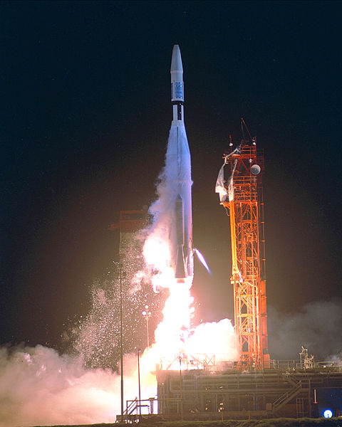
Some Crucial Software Bugs (3)
Mariner 1 Space Probe (1962)
Mariner 1 was the first spacecraft of the Americans Mariner program
Designed to explore Venus
Faulty application of the guidance commands
Destroyed 5 minutes after launch
Cost: $18.2 million
Reason: the overbar's resemblance to a hyphen ('‾' versus '-')

Slide 22
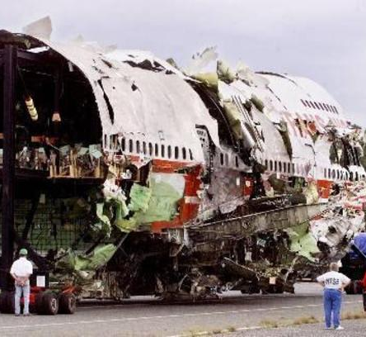
Some Crucial Software Bugs (4)
China Airlines Airbus A300-600R (1995)
Crashed and caught fire during landing at Nagoya Airport
Cost: $40 million + 264 lives lost
Reason: pilot mistake and lack of recommended software update (because China Airlines judged that "it was not urgent")

Slide 23

Some Crucial Software Bugs (5)
Ariane 5 Flight 501 (1996)
Europe's newest unmanned satellite-launching rocket
Destroyed 36.7 seconds after launch
Cost: $8 billion. Carrying $500 million satellite
Reason: software tried to cram 64-bit number in 16-bit space which resulted in overflow conditions
Video: https://youtu.be/qnHn8W1Em6E

Slide 24

Manual vs. Automation Testing
Manual Clicks vs. Automated Scripts

Slide 25
Manual and Automation Testing
Manual testing
Type of software testing in which tests are executed manually, without using any automated tools
A human performs the tests step by step, without test scripts
Tests are executed one-by-one in an individual manner
Automation testing
Type of software testing in which tests are executed automatically via test automation frameworks
Testers utilize tools and scripts to automate testing efforts
Requires coding and test maintenance

Slide 26
Manual vs. Automation
Aspect of Testing | Manual | Automation
Test Execution | Done manually by QA testers | Done automatically using automation tools and scripts
Test Efficiency | Time-consuming and less efficient | More testing in less time and greater efficiency
Types of Tasks | Entirely manual tasks | Most tasks can be automated, including real user simulations
Test Coverage | Difficult to ensure sufficient test coverage | Easy to ensure greater test coverage

Slide 27
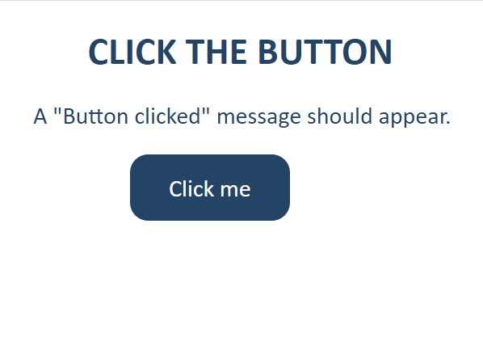
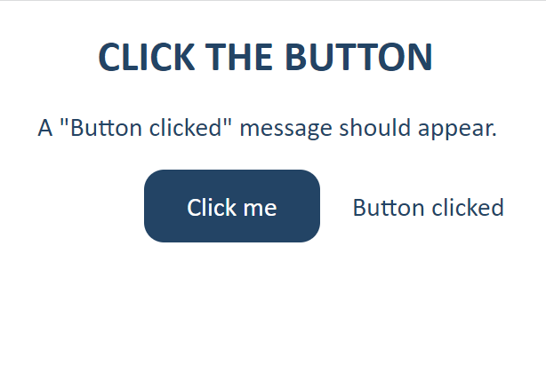
Manual Test Demo
http://softuni-qa-amazonaws.com/manual-qa-demo
Manual test

Slide 28
Automation Test Example
https://replit.com/@SoftUniQA/QA-Automation-Demo
QA-Automation-Demo.py
driver = webdriver.Chrome(options=chrome_options)
driver.get("https://manual-qa-demo.softuniqa.repl.co")
sleep(3)
button = driver.find_element(By.ID, "button")
button.click()
msg = driver.find_element(By.ID, "msg") assert msg.text == 'Button clicked'

Slide 29

Seven Testing Principles
The Philosophy of Software Testing

Slide 30

Seven Testing Principles (1)
Testing can show that defects are present
Cannot prove that there are no defects
Appropriate testing reduces the probability for defects
"Testing shows presence of defects, not their absence"

Slide 31
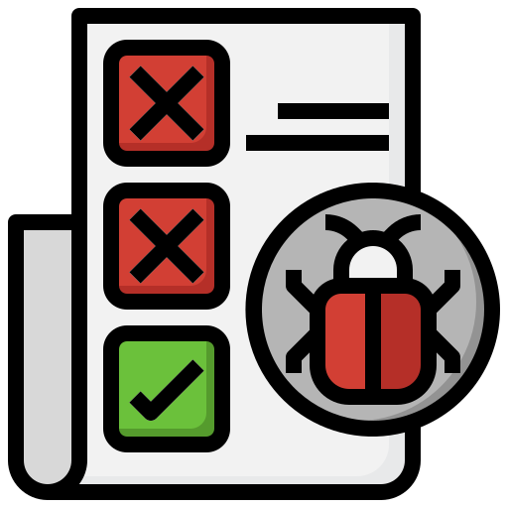
Seven Testing Principles (2)
All combinations of inputs and preconditions are usually almost infinite number
Testing everything is not feasible
Risk analysis and priorities should be used to focus testing efforts
"Exhaustive testing is impossible"

Slide 32
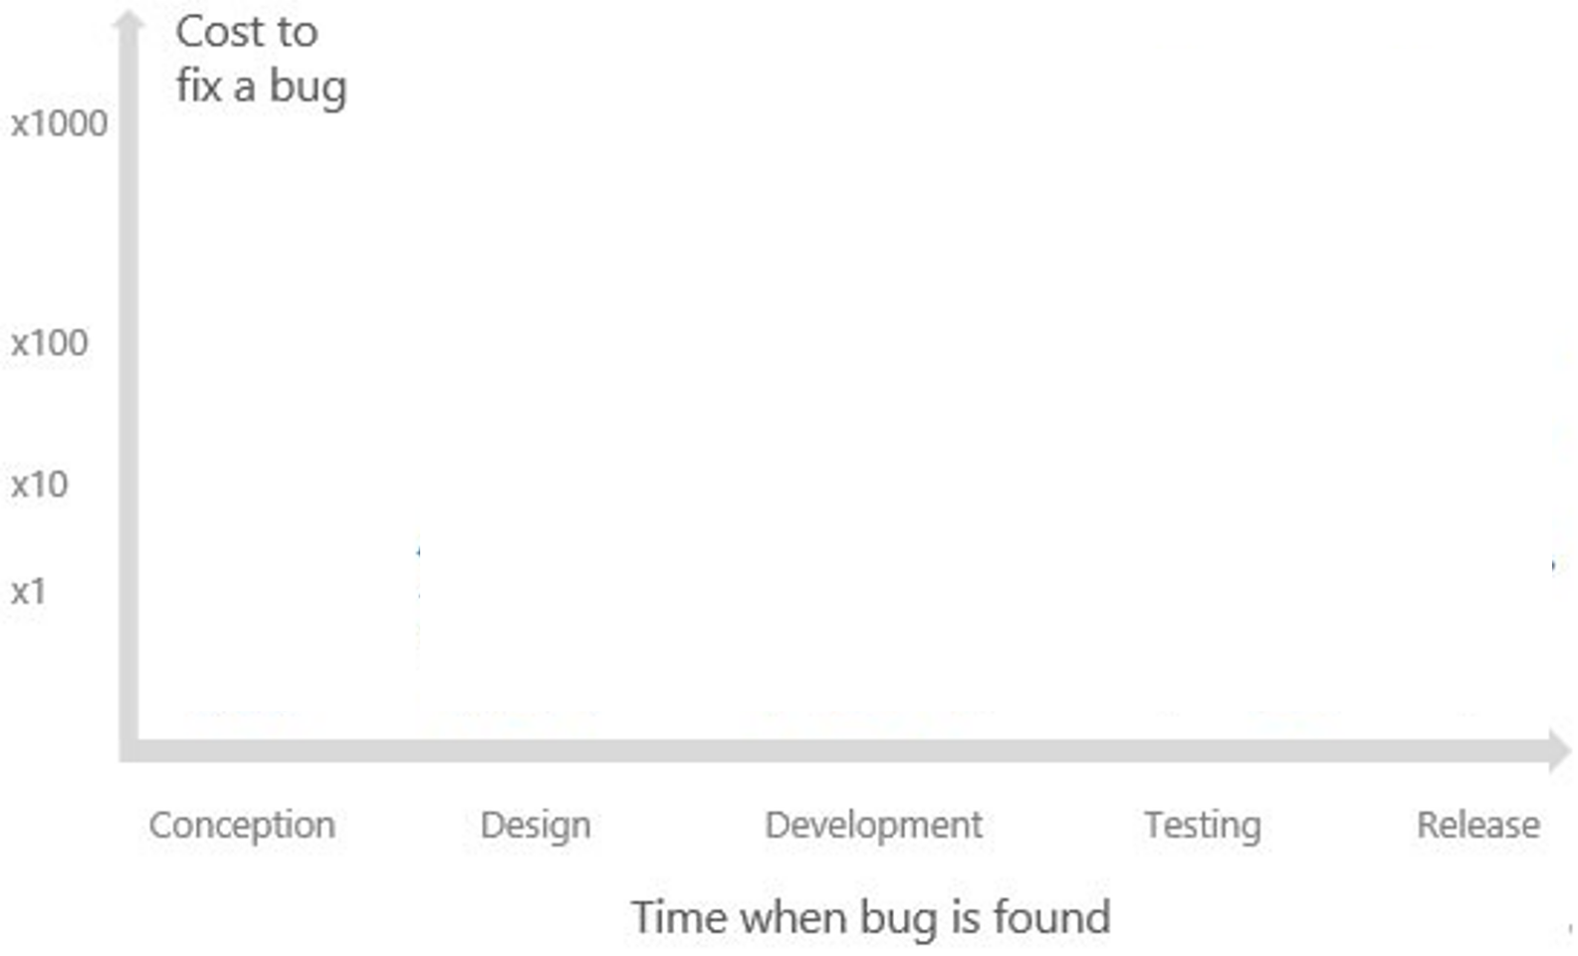

Seven Testing Principles (3)
"Early testing saves time and money"
Testing activities shall be started as early as possible
And shall be focused on predefined objectives
The later a bug is found – the more it costs!

Slide 33

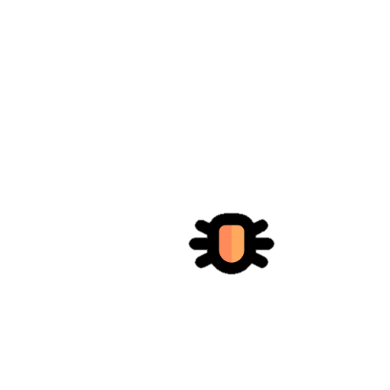
Seven Testing Principles (4)
Testing efforts should be focused proportionally
To the expected and later observed defect density of modules
A small number of modules usually contains most of the defects discovered
"Defects cluster together"

Slide 34
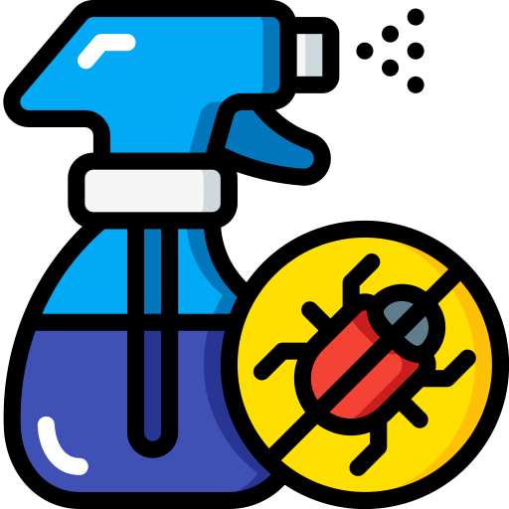
Seven Testing Principles (5)
Same tests repeated over and over again, tend to lose their effectiveness
Previously undetected defects remain undiscovered
New and modified test cases should be developed
"Beware of the pesticide paradox"

Slide 35

Seven Testing Principles (6)
Testing is done differently in different contexts
Safety-critical software should be tested differently from an e-commerce site
"Testing is context dependent"

Slide 36
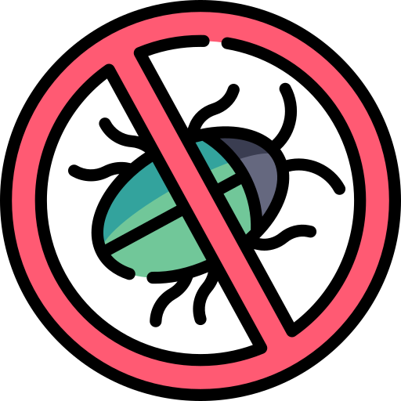
Seven Testing Principles (7)
Finding and fixing defects itself does not help in these cases:
The system built is unusable
Does not fulfill the users' needs and expectations
"Absence of errors is a fallacy"

Slide 37

Test Scenarios
Stories to be Tested

Slide 38
Test Scenario
What is a "test scenario"?
Any functionality / feature / user story that can be tested
Also called story under test or feature under test
Example: test the login form
Why we need it?
Complicated systems can be split into set of test scenarios
Serve as a quick tool to determine testing work effort
For studying end-to-end functioning of the program

Slide 39
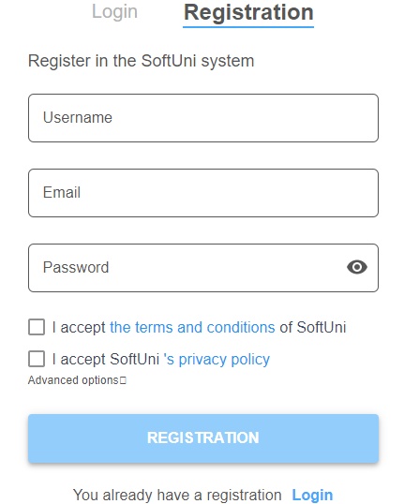
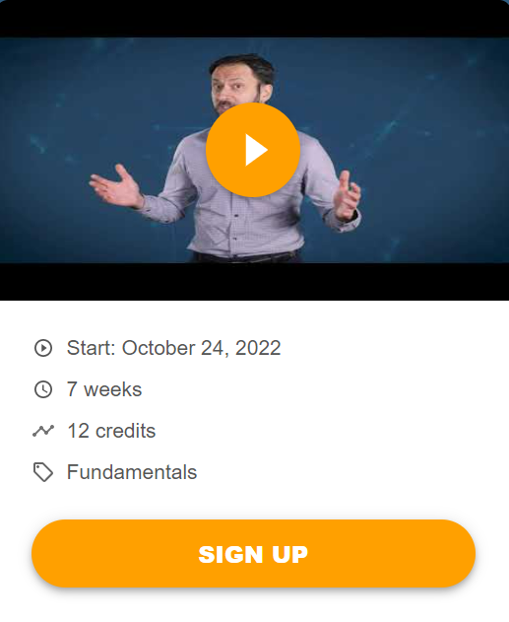
Example: Test Scenarios
Test scenario 1:
Register to the platform
Test scenario 2:
Enroll in a course

Slide 40
Test Scenarios and Test Cases
One test scenario typically includes several test cases
Example:
User story: Users should be able to login
Test scenario: Login with user + password
Test cases:
Login with valid user + pass → success
Login with invalid user + pass → error
Test Case #1
User Story
Test Scenario
Test Case #2
Test Case #3

Slide 41

How to Write Test Scenarios?
Read requirement documents
Figure out possible user actions for each requirement
Write a test scenario for each feature
Design tests to cover the normal user flow
Design tests to cover the unexpected user flow
Make sure every requirement is covered
Handout the scenarios for review

Slide 42

Test Cases
Tests of a Single Execution Path

Slide 43
Test Cases
What is a test case?
A sequence of actions executed to verify a particular use of a feature or functionality (a particular execution path)
May include specific input and output conditions
Why do we need it?
Compare expected to actual results for а certain execution path
Examines the functioning of a software component with certain input and under certain entrance conditions

Slide 44

Test Case
Sequence of steps to check the correct behavior
At least two cases to fully test certain scenario
A positive test
A negative test
Test cases consist of:
Title (+ optional description)
Steps to follow
Expected result
44

Slide 45


Test Case – Structure and Example
Title: Brew a small coffee
Description: start the coffee machine, fill water and ground coffee, and brew a cup of coffee.
Steps:
Power on the machine.
Put ground coffee blend in the coffee outlet.
Fill the water container to its max level.
…
Expected results:
The brew process should complete in < 50 seconds.
The coffee cup should hold a hot small coffee (60 ml).
…
Title: <test title>
Description: <short overview>
Steps: <the testing procedure>
…
…
…
Expected results:
…
…
…

Slide 46
Test Scenarios and Test Cases – Example
Sample test scenario:
Register to the platform
Test cases for this scenario:
Non-existing valid username → success
Duplicated username → error
Empty username or password → error
Too long username → error
Invalid characters in username / password → error
User Registration
Username:
maria
Password:
•••••••••••
Full Name:
Maria Steward
Register

Slide 47

Summary
…
…
…
Definition of SQA
Definition of Software Testing
Software Defects / Bugs
Manual and Automation Testing
Seven Testing Principles
Test Scenarios: test a user story
Test Cases: test a single function

Slide 48
Questions?
Notes:
48

Slide 49














SoftUni Diamond Partners

Slide 50

Educational Partners

Slide 51

License
This course (slides, examples, demos, exercises, homework, documents, videos and other assets) is copyrighted content
Unauthorized copy, reproduction or use is illegal
© SoftUni – https://about.softuni.bg/
© Software University – https://softuni.bg
Notes:
51

Slide 52
Trainings @ Software University (SoftUni)
Software University – High-Quality Education, Profession and Job for Software Developers
softuni.bg, about.softuni.bg
Software University Foundation
softuni.foundation
Software University @ Facebook
facebook.com/SoftwareUniversity
Software University Forums
forum.softuni.bg
Notes:
52

